Slide 1
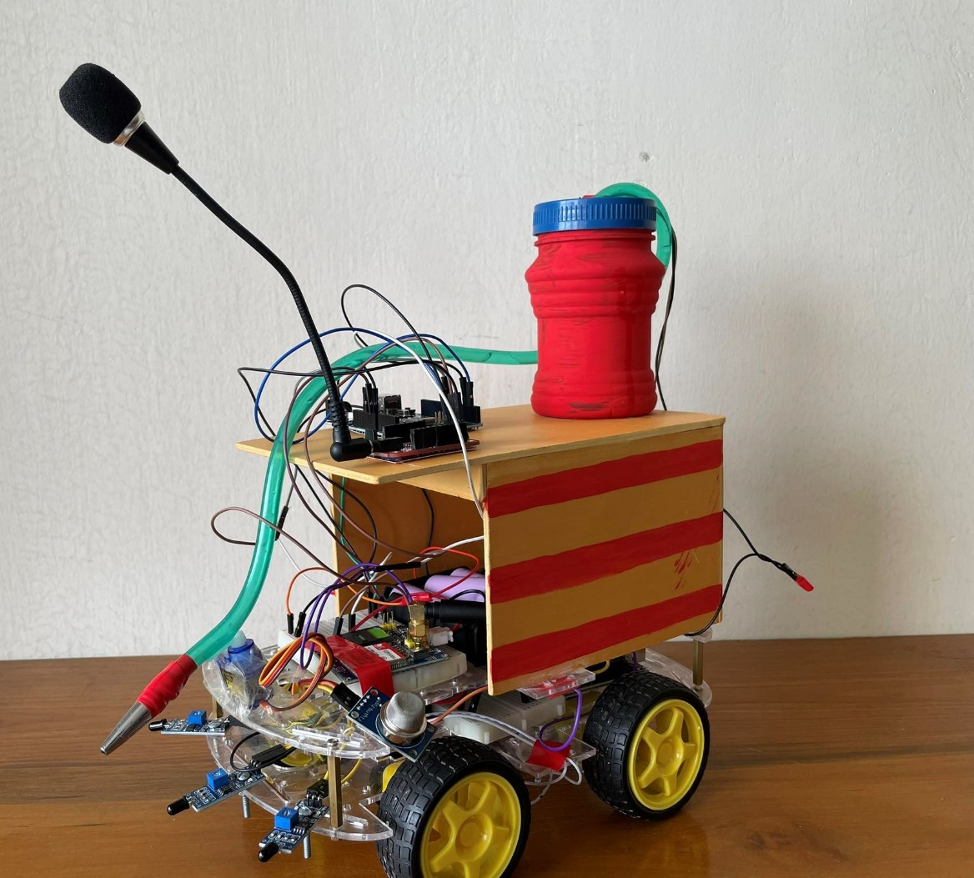
Fire Fighting and Rescue Bot with Bangla Voice Detection Technology
Presented by-
Group: 03
Nowshin Lubaba- 1906038
Abrar Mahir- 1906039
Al Mahmud Sajid- 1906050
Mohammad Ismail Chowdhury- 1906058
Hasib Ur Rashid Ifti- 1906059

Slide 2
Working
Detects fire using IR sensor and MQ2 gas sensor
Moves towards the fire
Mitigates fire using DC pump
Detects presence of victim when called for help
and notifies control authority using voice recognition
technology in Bangla
Community of practice: Laboratories and other specialised rooms in risk of fire hazard at high rise buildings

Slide 3
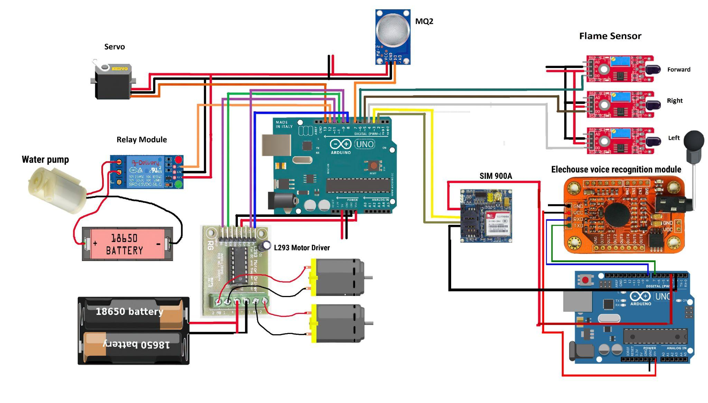
Methodology

Slide 4
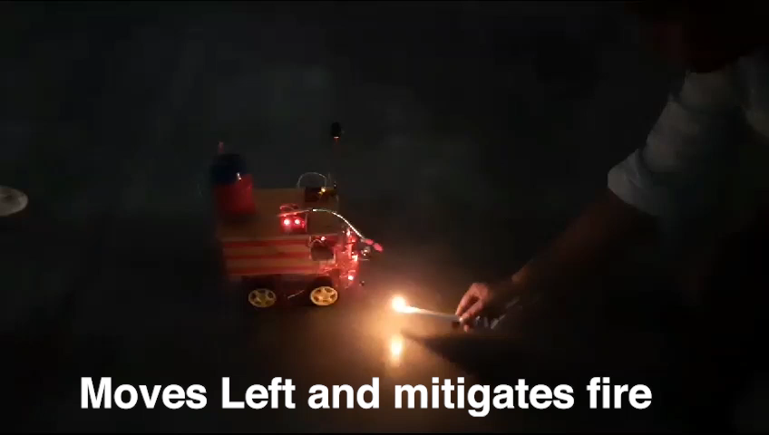
Demonstration Video

Slide 5


Novelty
Features a MQ2 gas sensor otherwise
absent in commercial fire fighting bots
Features voice recognition using Elechouse
Voice Recognition Module
Uses solar powered charger to recharge
Batteries used. SDG goal 7 aims to ensure access
to affordable, reliable and sustainable energy
for all and it is a step in that direction
SDG goal 9 aims to provide safe, resilient and sustainable infrastructure and industrialisation

Slide 6
Scopes of Improvement
Image processing would’ve given a more accurate result
along with high end alternatives like Raspberry Pi (Around 17000 BDT compared to Arduino Uno’s 800 BDT price point)
Alternatively, use high-end IR sensors and motor drivers (6650 BDT compared to 450 BDT).
Use higher quality microphones for voice recognition (13500 BDT)
Use aluminum based batteries as a cleaner alternative since they’re one of the most recyclable options (6.5-7.5 USD each)
OTA (Over the air firmware update) which updates features
easily when bot is deployed at client end
Data acquisition and monitoring system from user end like gas or temperature parameters which can give alarm if trend goes wrong for
forecasts and prevent potential fire incident
Reference: Munirul Alam, CEO, Inovace Technologies

Slide 7
Scalability
- Existing market of current Tech Firms like Inovace Technology don’t have fire fighting robot in their pipeline, providing a prospect for us to be the first ones
- A good and commercially sustainable product as per industry experts
- Since fire spreads rapidly in high rise buildings, a fire mitigation and rescue bot in high rise buildings could ease the job of fire fighters beforehand
Reference: Md. Al Masud, Inspector, Palashi Barrack Fire Station

Slide 8
Cost Analysis
Component | Price
Arduino x 2 | 1300
Elechouse module | 2900
Breadboard x 2 | 140
GSM 900a | 700
Chassis, wheel and motor | 1800
Motor Driver L298D | 450
IR Sensors x 3 | 300
Gas Sensor MQ2 | 150
Relay | 75
Servo | 150
Battery and Holder | 1550
Others | 150
Total | 9665

Slide 9
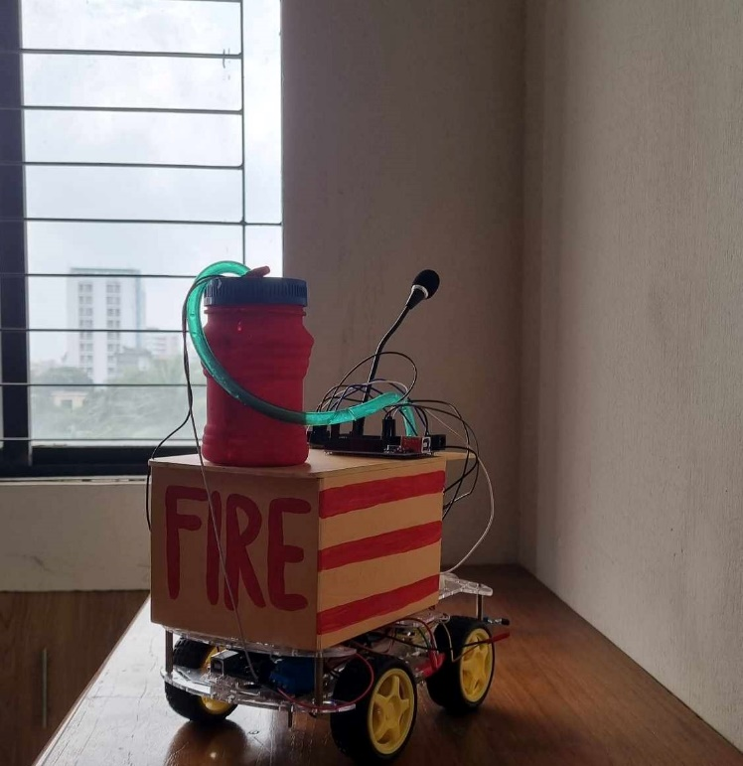
Thank you.
Any questions?

